Slide 1


Web Services - Spring Boot RESTFul Application
Project : DiaCare
Done by:
Amrutha Nair THALAPPAN (21911345)
Pratik PARIKH (21912054)

Slide 2
Project Cycle of DiaCare
• Planning
01
• Design
02
• Implement
03
04
• Test and Deploy

Slide 3

Main Features of DaiCare Application
Login
Registration
Daily Readings
Weekly Report
Note Taking
Client Security

Slide 4
Design First Approach – Swagger.io
Planning
Swagger implementation
Project Export from Swagger
Build APIs Logic
Test APIs with PostMan
Client Application with PrimeFace and javascript (ajax)
Client Security

Slide 5
Leverageing features of SpringBoot Frame Work
Hibernate: Automatically creating/updating the db tables
Auto Configuration of Applicaiton Execution Environment
Automisatoin of Documentaiton
JPA: Management of relational data in applications using Java Platform

Slide 6
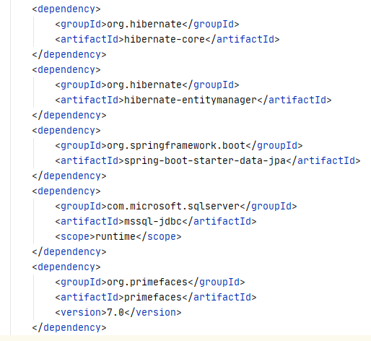
Maven dependencies
hibernate-core
hibernate-entitymanager
spring-boot-starter-data-jpa
mssql-jdbc
primefaces

Slide 7
Annotations
@RequestMapping
@Postmapping
@Putmapping
@Getmapping
@Autowired
Hibernate annotations:
@Table
@Entity
@Column
@Id
@GeneratedValue(strategy= GenerationType.IDENTITY)
@Service
@Repository
@JsonProperty
@Override

Slide 8

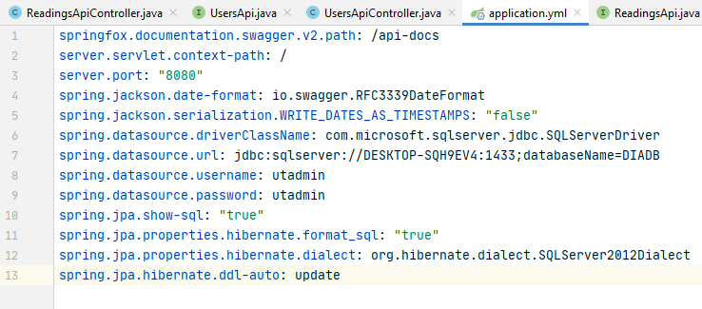



Application.yaml - Easy to edit with text editor. - Expressive and extensible. - Unicode character set. - Portable between technology

Slide 9
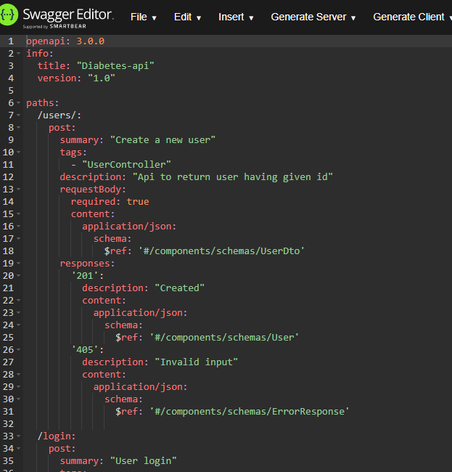
Swagger File :

Slide 10
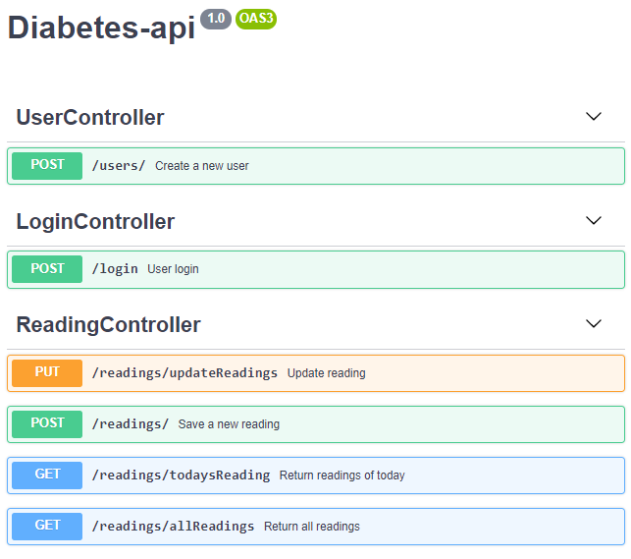
Swagger File :

Slide 11
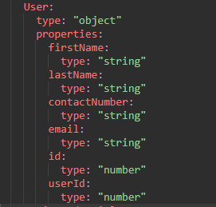
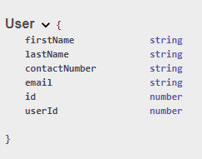
Swagger File :

Slide 12
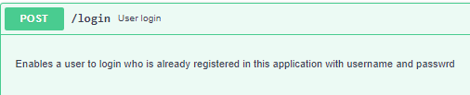
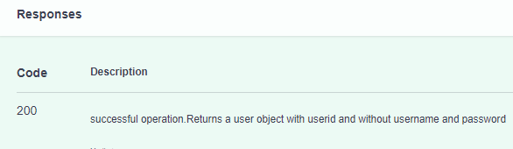
Documentation of APIs Auto-update of Api documentation

Slide 13
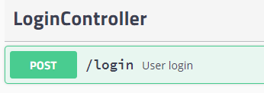
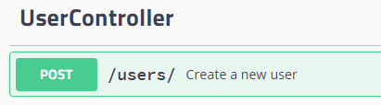
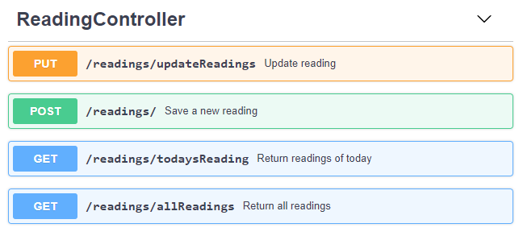
CRUD Operations:
Authenticate User
Create new Uses
Reading operations

Slide 14
Implementation :
JPA
PrimeFace
YAML
SWAGGER
SQL
Spring boot

Slide 15
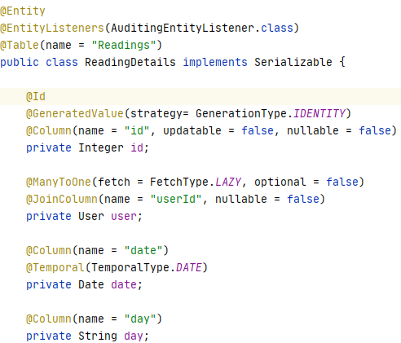
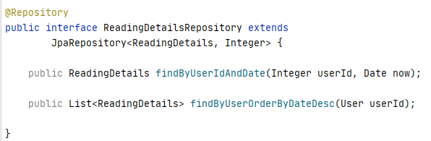
Table generation
Database communication

Slide 16
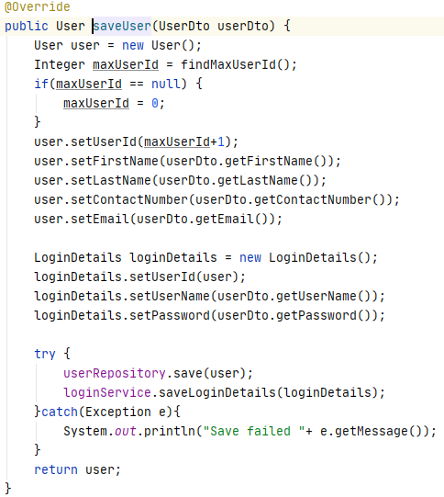
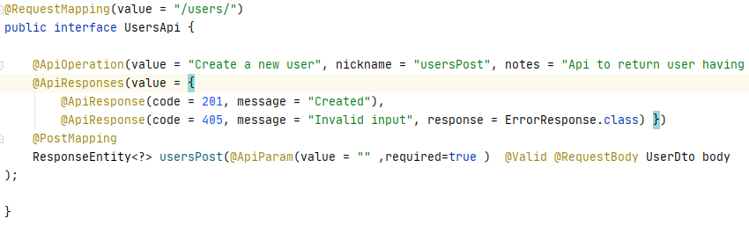
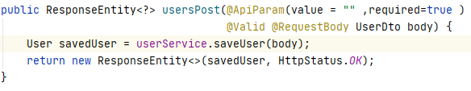
API Implementation:
User registration API

Slide 17
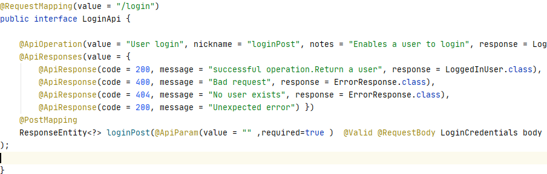
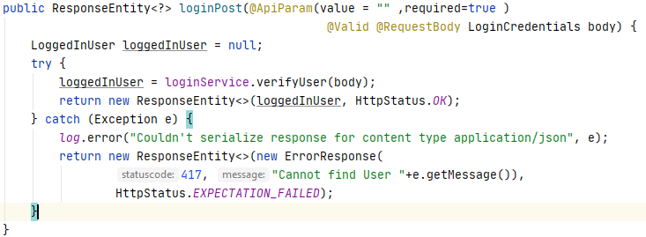
API Implementation:
Login API

Slide 18
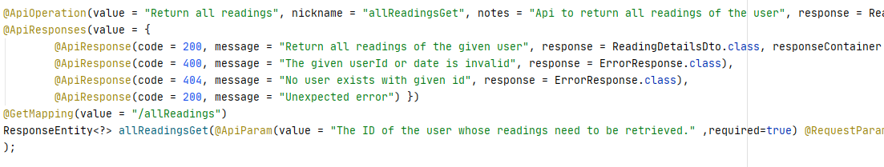
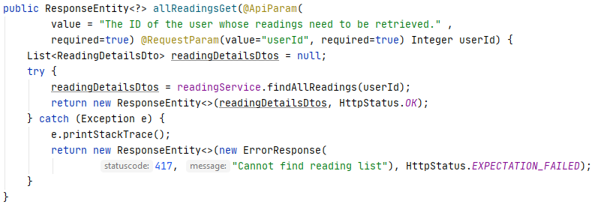
API Implementation:
Reading List API

Slide 19
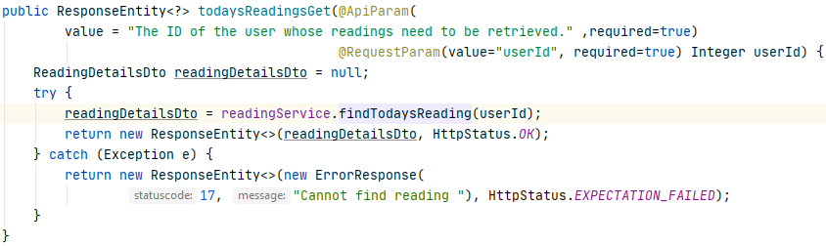
API Implementation:
API to get today’s reading

Slide 20
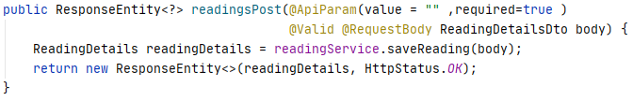
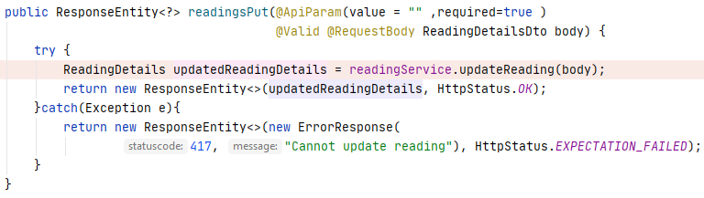
API Implementation:
Save Reading API
Update Reading API

Slide 21
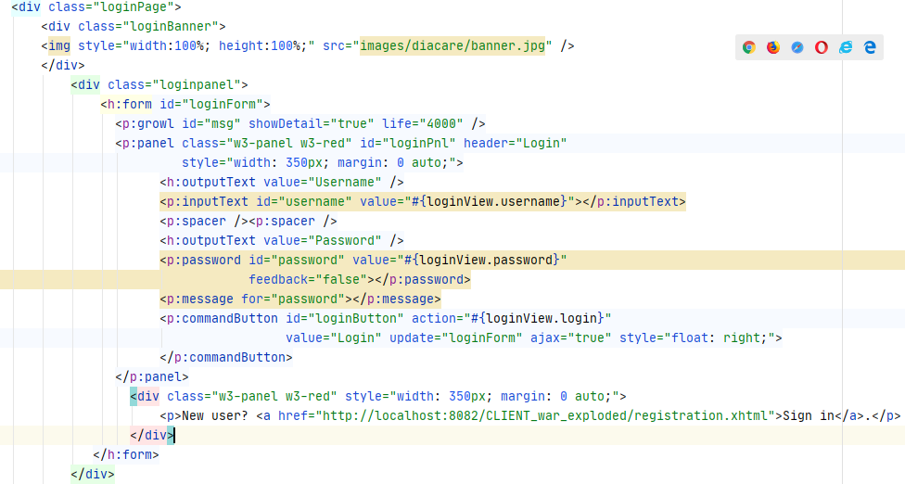
User Inteface
UI using Primeface framework
Loginpage:

Slide 22
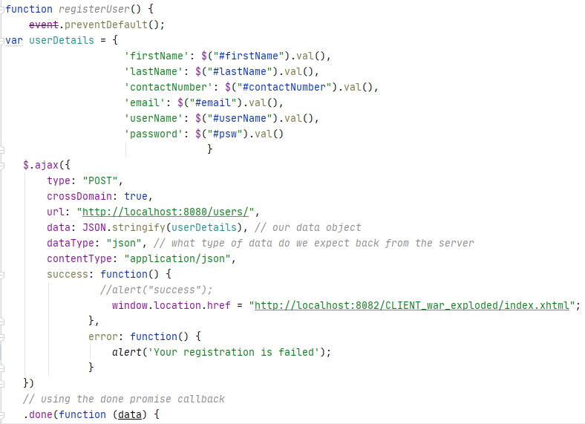
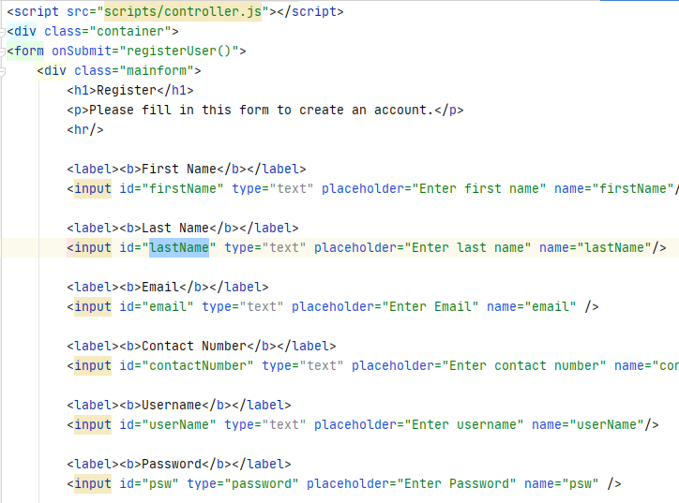
User Inteface
Javascript
Registration page API integration using Javascript

Slide 23
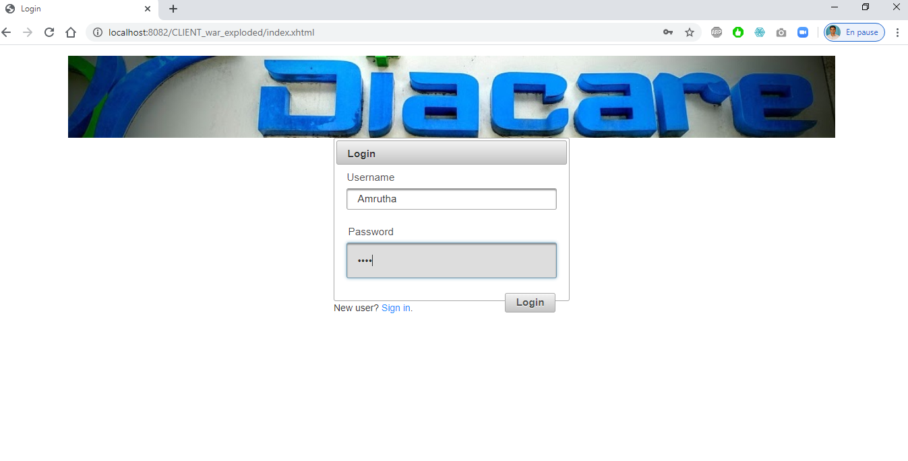

Login Page:

Slide 24
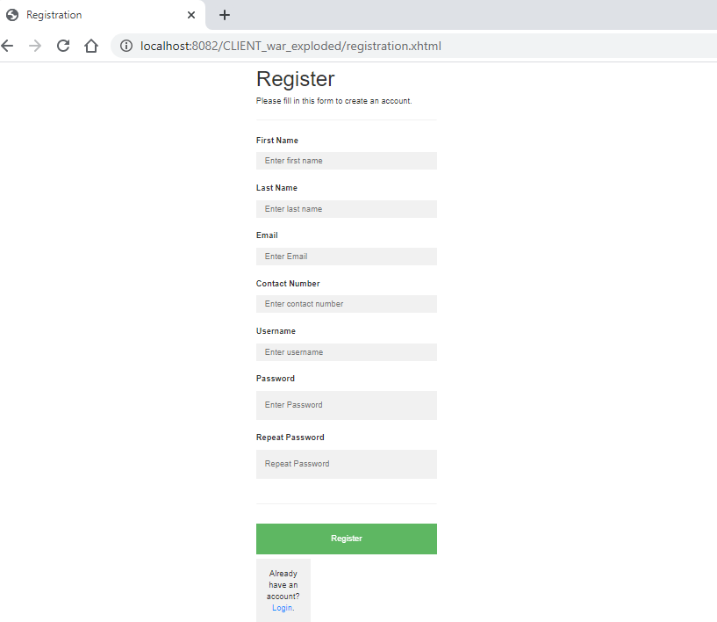
Registration Page:

Slide 25
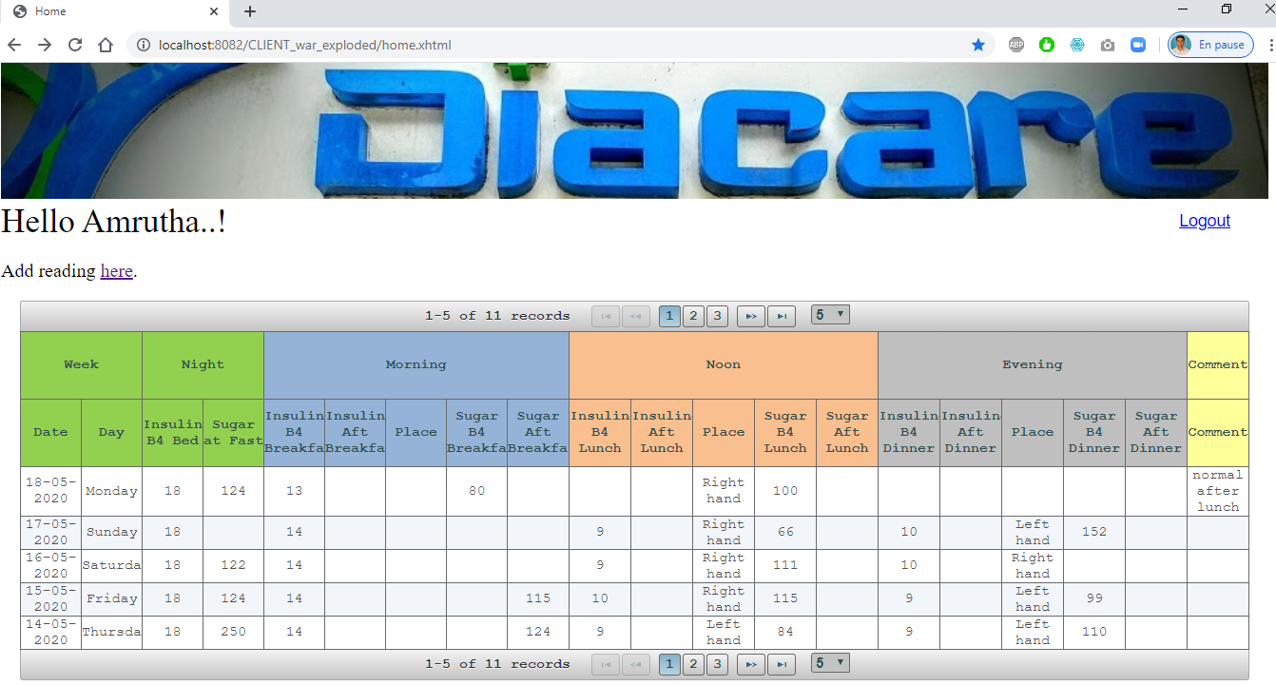
Weekly report:
Weekly summary of Sugar Level
Easy monitoring of Sugar Level
Share the Report to Doctor

Slide 26
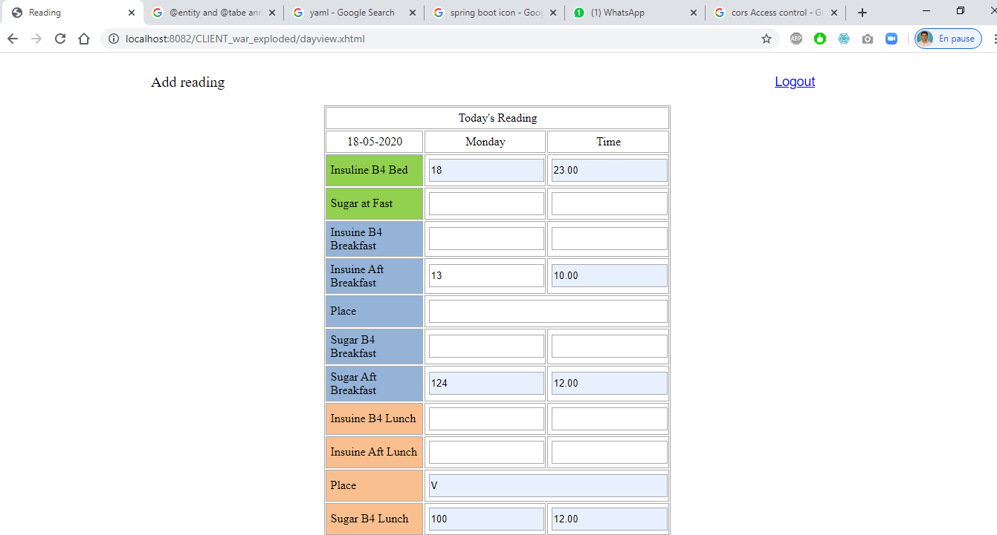

Daily Observation Page:
Record Sugar Level
Record Insulin intake in ml
Place of injecting the niddle

Slide 27
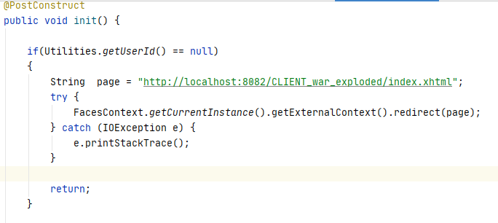
Client security
Redirecting to login page whenever taking another page if the user is not logged in.

Slide 28

Thanks!

